Slide 1

Assignment
III
Luke Profio

Slide 2
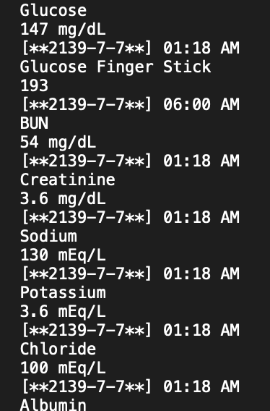
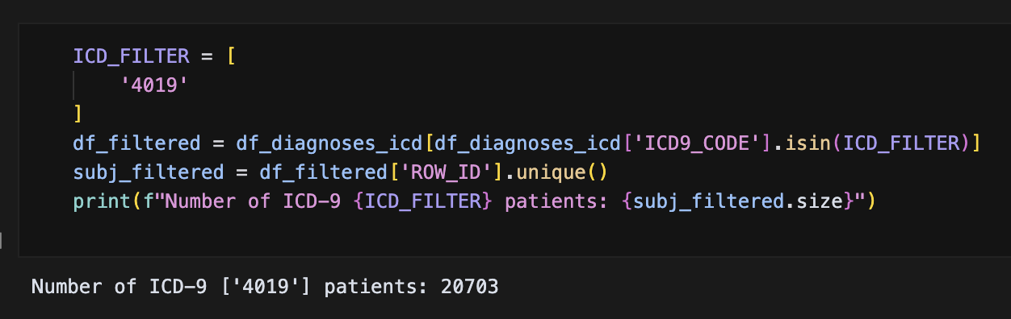
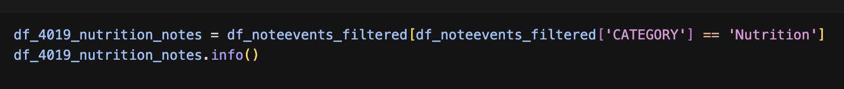
Extracted Notes
Here we extract notes from ICD code 4019, patients with Unspecified Essential Hypertension.
Of these notes, we filter for nutrition by category.
This filters notes from patients with Unspecified Essential Hypertension for their nutritional panel notes (e.g. glucose levels).

Slide 3
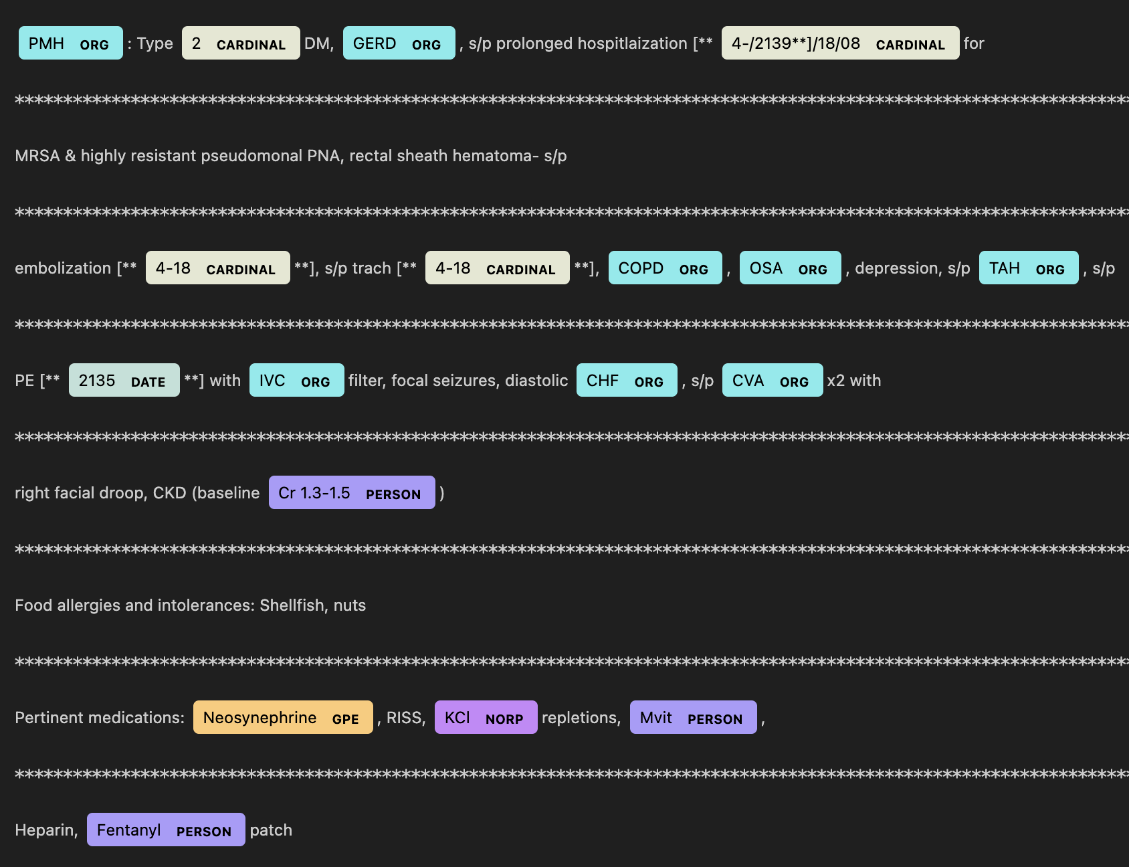
Displacy-Extracted Values (Spacy)
Here we are provided the generic Spacy-extracted entities.
Overall, the utility of these entities is low.
Many entities are inaccurate (e.g. Mvit, or multivitamin, marked as a ‘person’).

Slide 4
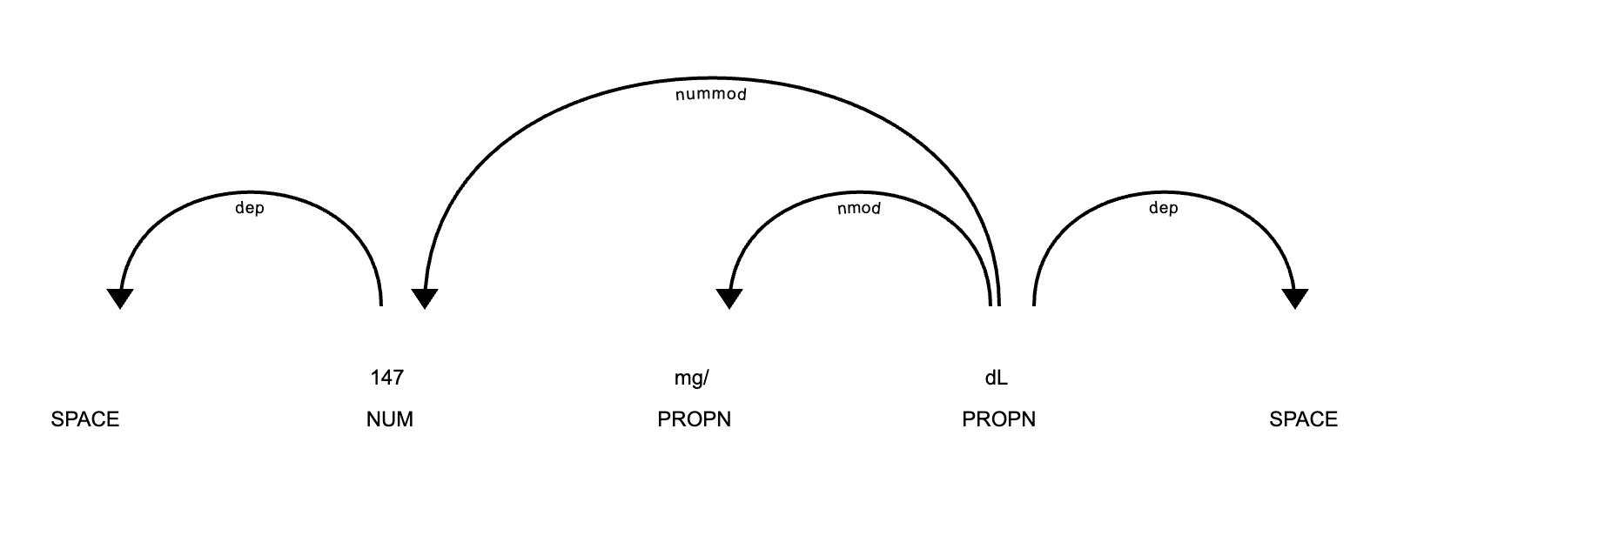
Sentence Dependency Tree (Spacy)
Here we are provided a dependency tree on the sentence level.
Spacy effectively models numeric relations relevant to nutritional values, such as metrics.
For example, 147 mg/dL is modeled as follows:

Slide 5
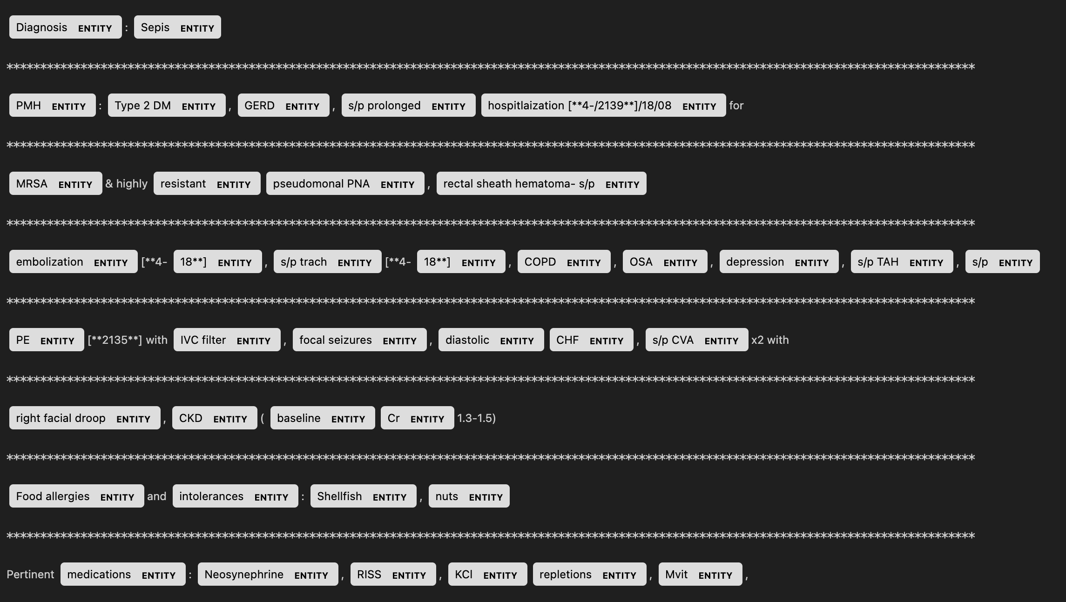
Displacy-Extracted Values (SciSpacy)
Prior to more enriched SciSpacy extraction, we mark all relevant entities.
This process is efficient, with a high percentage capture of appropriate entities (e.g. chemicals).
Note: my notebook may not have been fully executed due to a memory/runtime constraint.

Slide 6
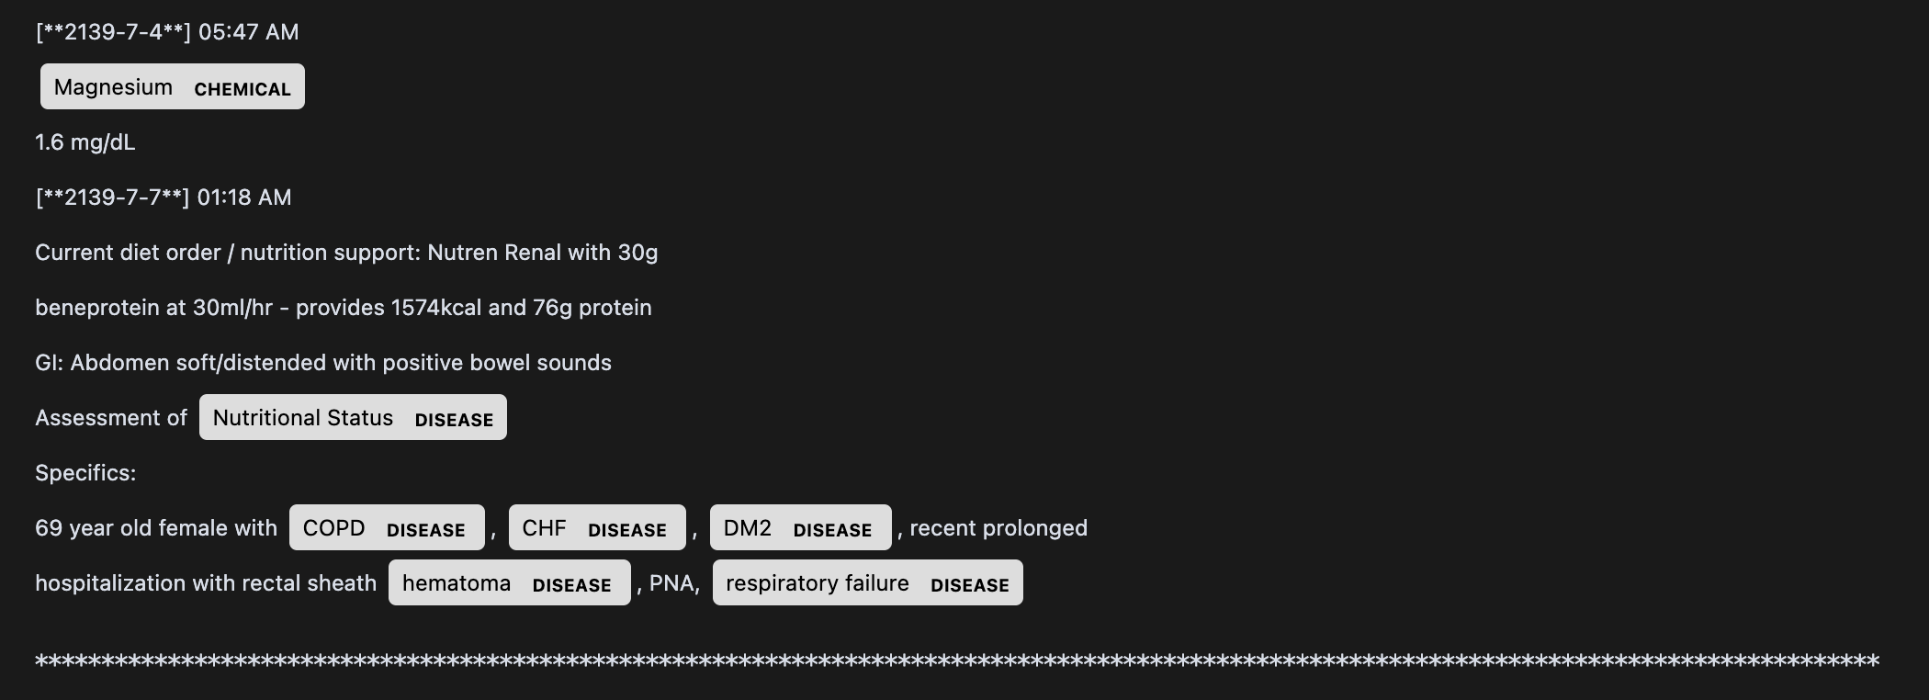
Displacy-Extracted Values (SciSpacy)
As seen below, SciSpacy is significantly more effective at extracting relevant values, such as diseases (e.g. COPD) and chemicals (e.g. Magnesium).
This tagging is critical to monitor nutritional values and infer broader trends (e.g. relationship between nutrition and disease state).

Slide 7
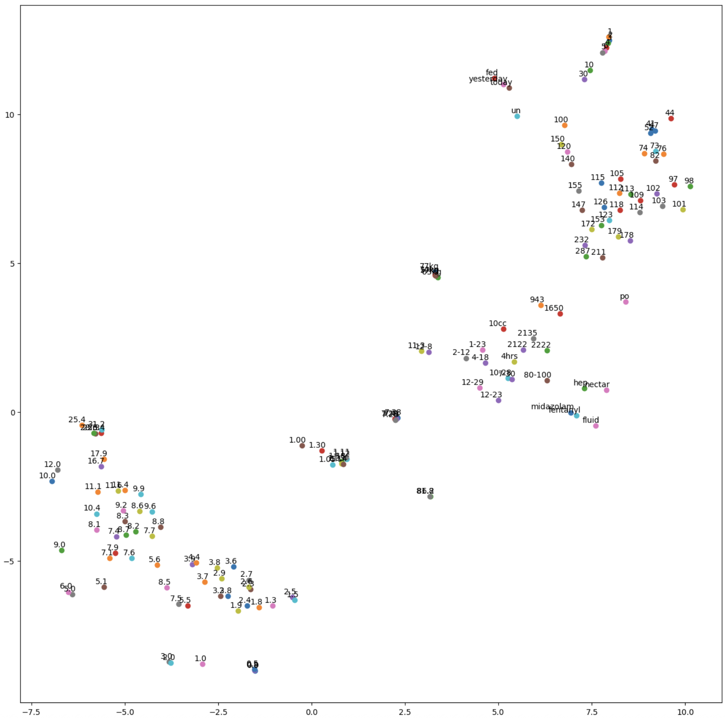
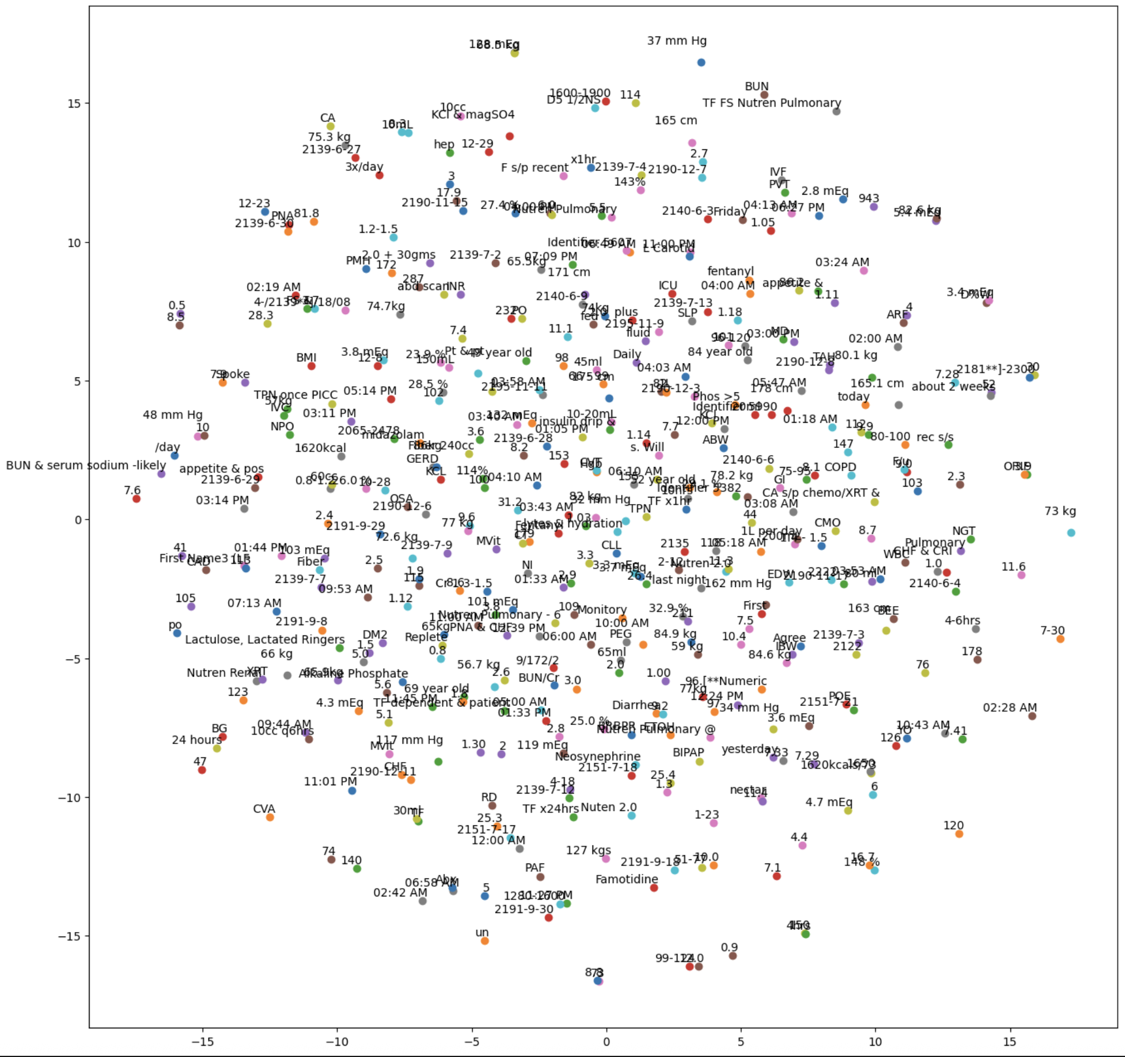
Word2Vec tSNE Plot (Spacy)
Given the total amount of numeric outputs and disparate note content, there is not much utility nor grouping in the tSNE plot.
This could be due to Spacy’s limited entity extraction explored earlier.

Slide 8
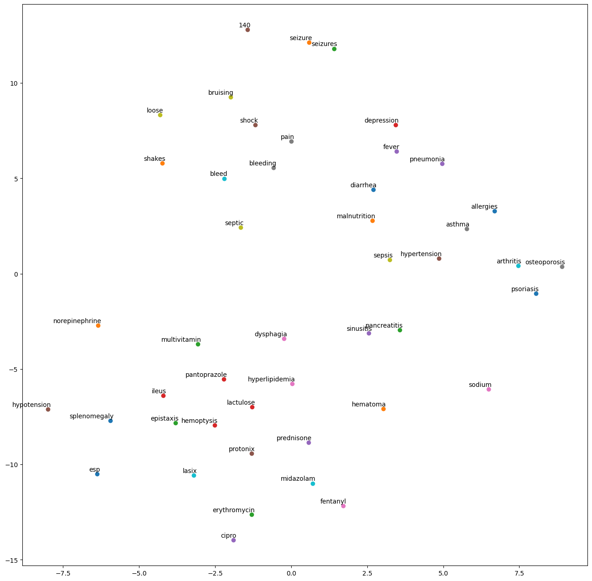
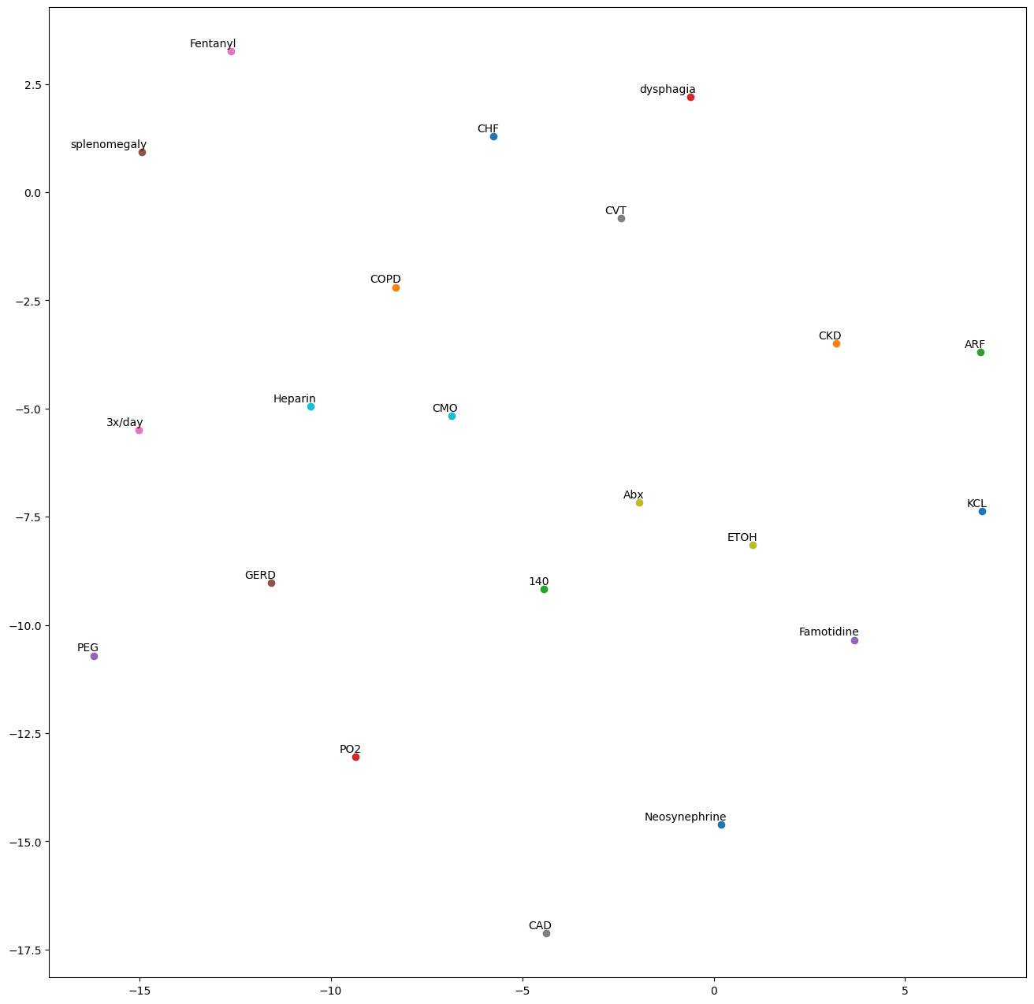
Word2Vec tSNE Plot (SciSpacy)
There is a clear improvement in the tSNE plots of SciSpacy.
Entities are no longer scattered, and have a more logical grouping (e.g. fever nearby pneumonia).
Overall there are significantly less entities, and they are of higher quality (e.g. chemicals, diseases).

Slide 9
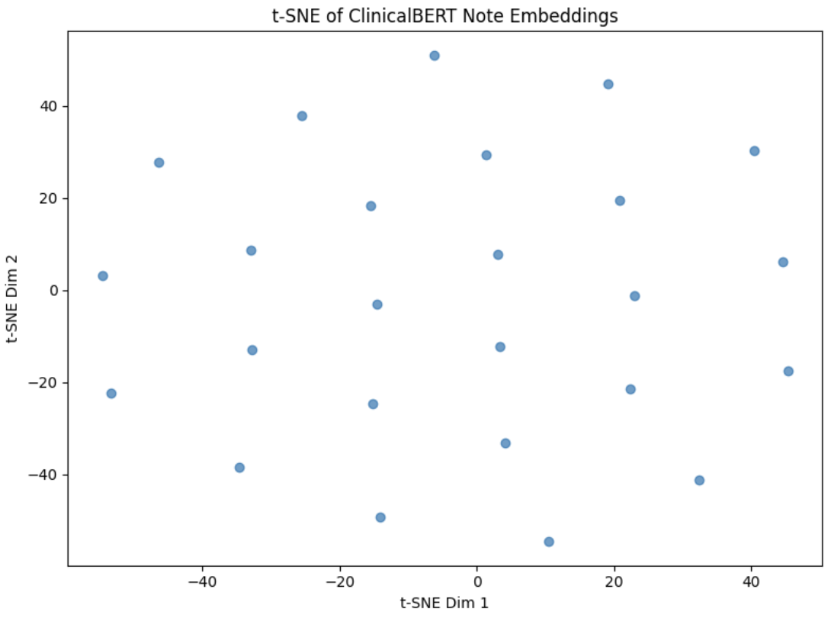
ClinicalBert tSNE Plot
Embeddings Tensor Shape: ([25, 768])
Notes were read in, tokenized, and passed through ClinicalBERT prior to mean-pool in the last hidden states to get a fixed-size vector per note.
To visualize with t-SNE, we reduce the stack of embeddings from 768 down to 2 dimensions via PCA, with a scatter plot to reveal any semantic clusters.
Given clusters are equally apart from one another, the data is relatively homogenous with no clear subpopulations.

